Slide 1
Visualization In tableau
TITANIC DATASET
CHARAN N

Slide 2
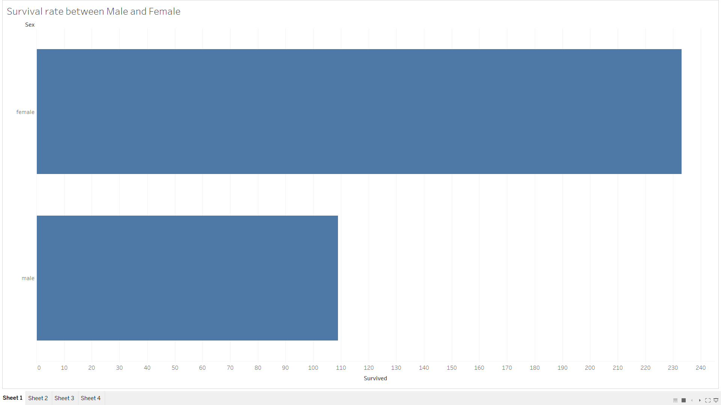
Survival rate between Male and Female:
Analyzing the survival rate between male and female passengers in the Titanic dataset is useful for understanding potential gender-based disparities in survival outcomes during the disaster. This visualization can provide insights into whether there was a significant difference in the likelihood of survival for men and women. Such information may contribute to broader discussions about the evacuation and rescue efforts, societal norms, and the effectiveness of the "women and children first" policy that was historically associated with maritime disasters.

Slide 3
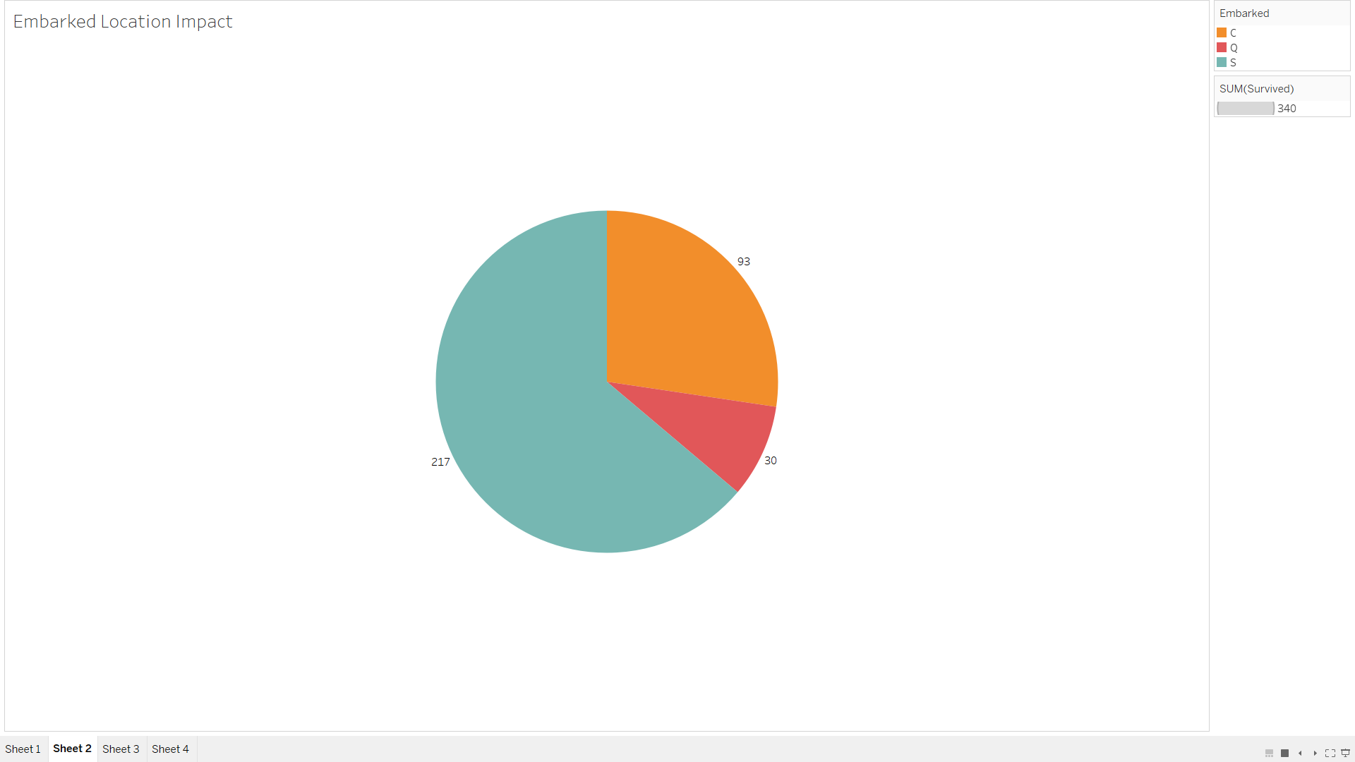
Embarked Location Impact
Analyzing the impact of the embarked location on survival rates provides insights into potential factors influencing passenger outcomes based on where they boarded the Titanic. This visualization can offer a glimpse into the effectiveness of evacuation procedures, variations in passenger demographics across embarkation points, and the overall role of geographical factors in survival during the tragic event. Understanding these dynamics contributes to a more comprehensive narrative about the Titanic disaster and the varied experiences of passengers based on their point of embarkation.

Slide 4
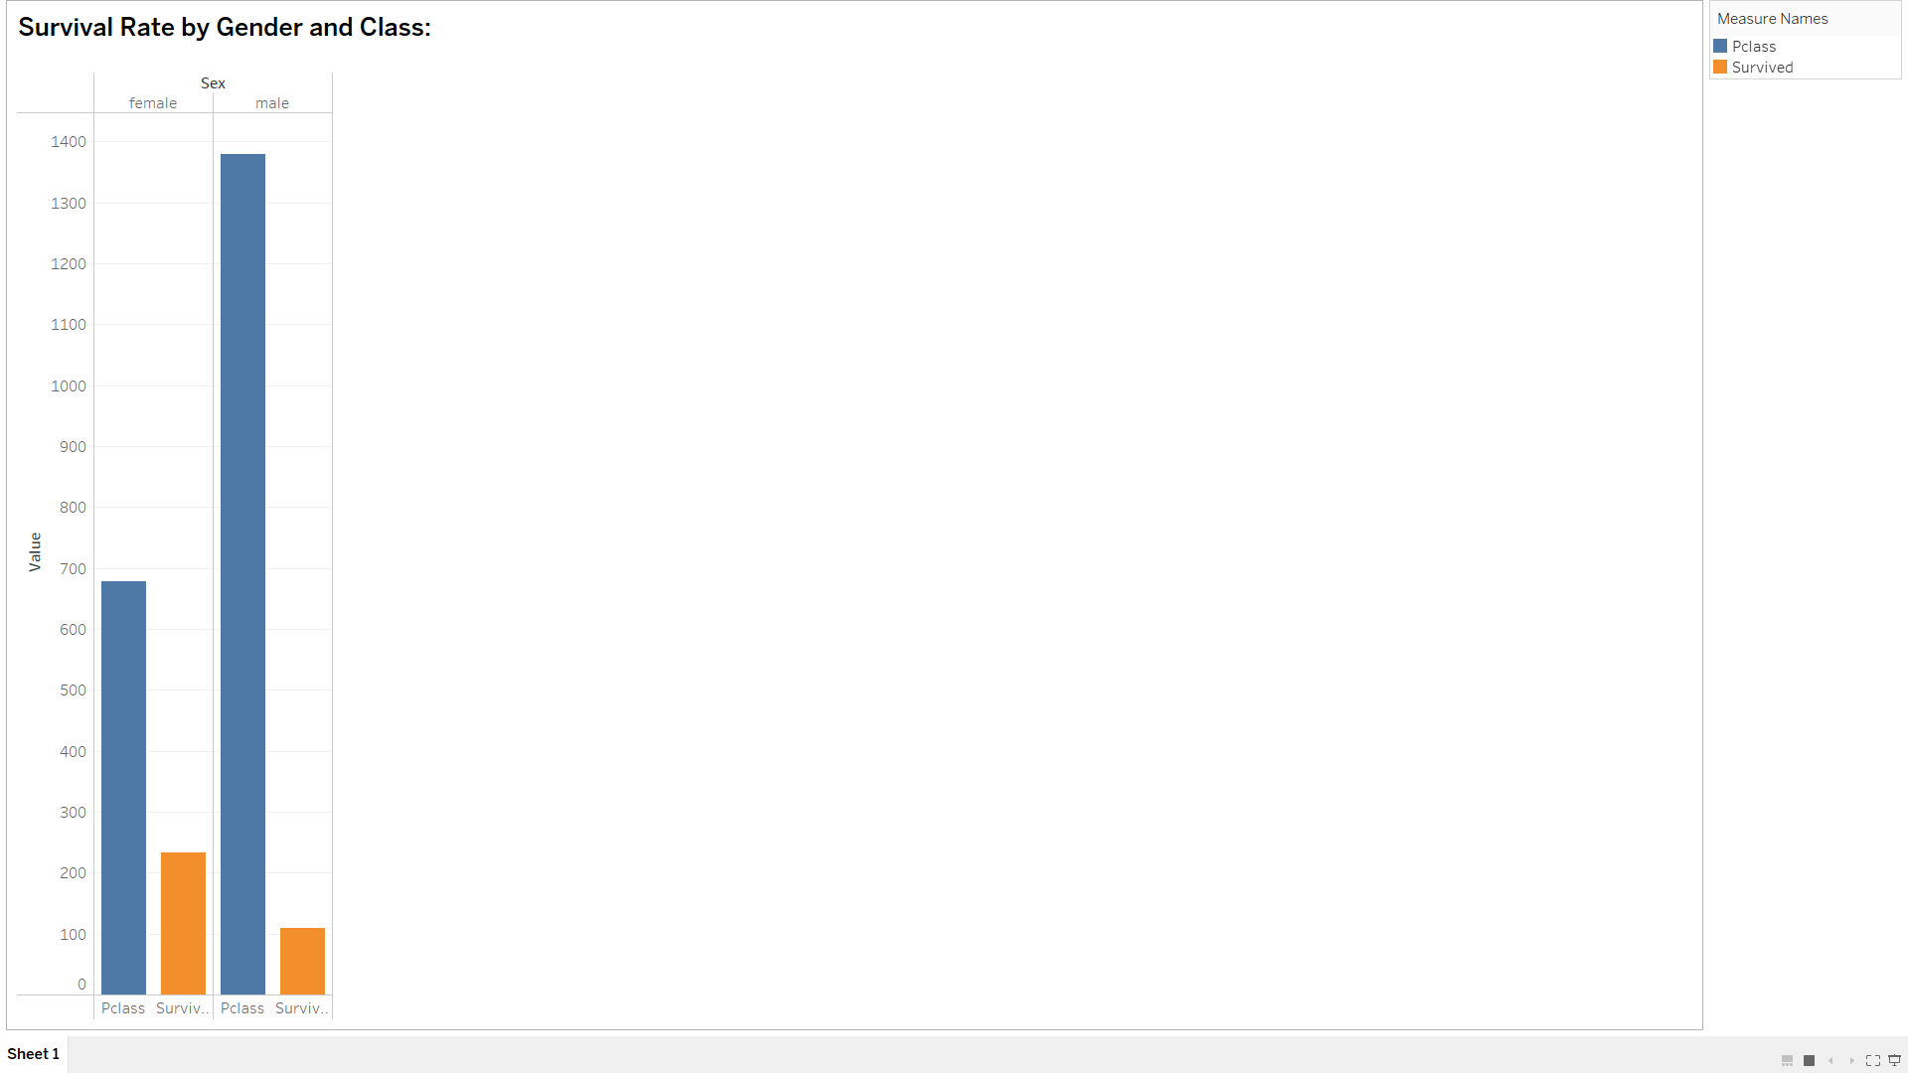
Survival Rate by Gender and Class:
Analyzing the survival rate by gender and class in the Titanic dataset provides valuable insights into how different demographic factors influenced passengers' chances of survival. This visualization helps discern patterns and potential disparities in survival outcomes among male and female passengers across various classes. The information gleaned can contribute to a deeper understanding of the socio-economic dynamics and evacuation priorities during the Titanic disaster, offering historical context and shedding light on the effectiveness of emergency response measures.

